Slide 1





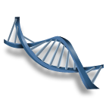
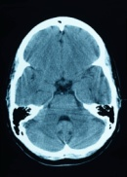


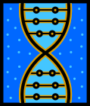



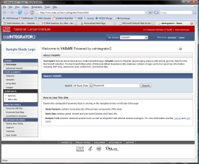
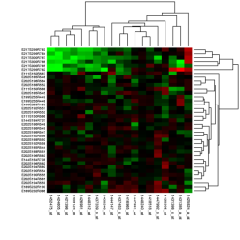
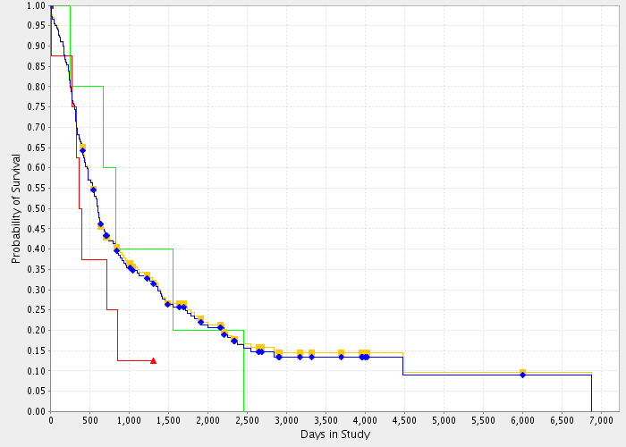
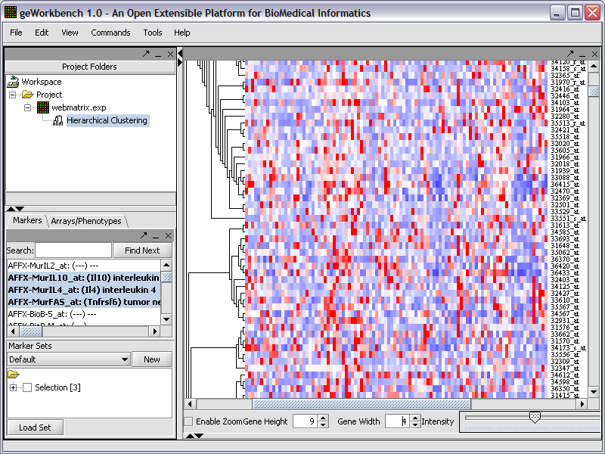
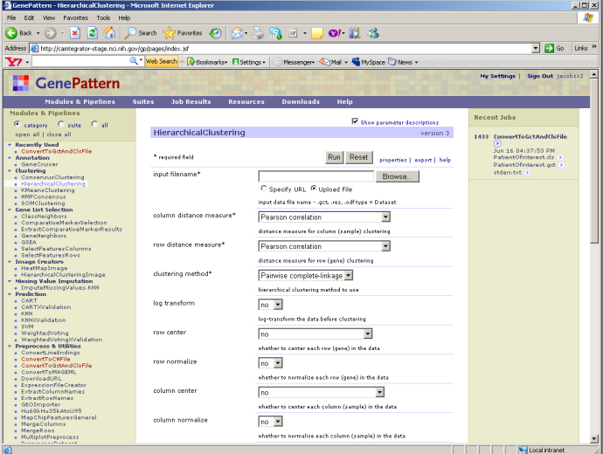
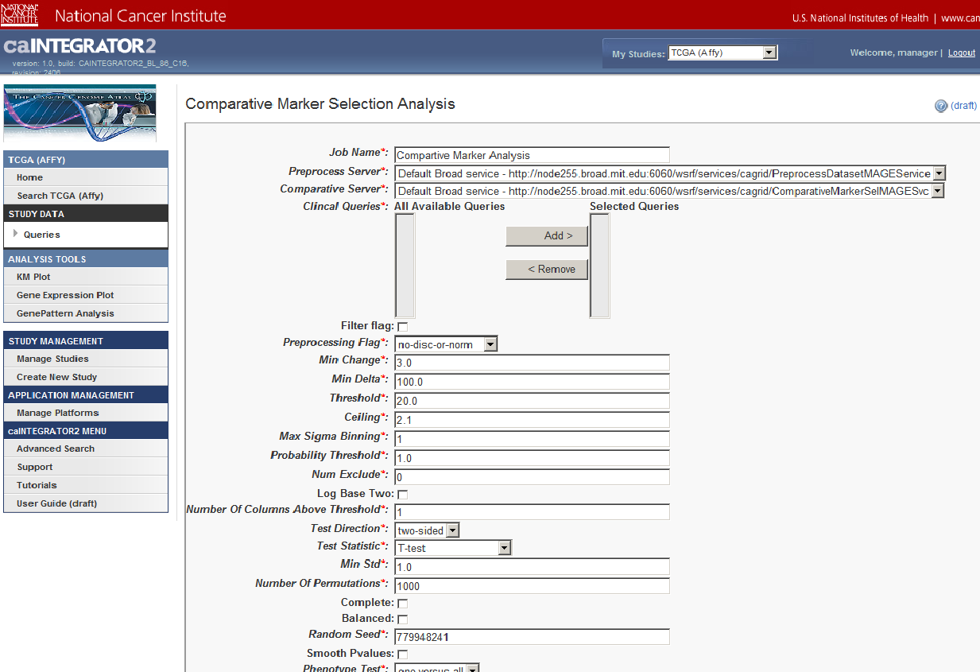
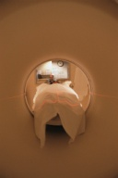
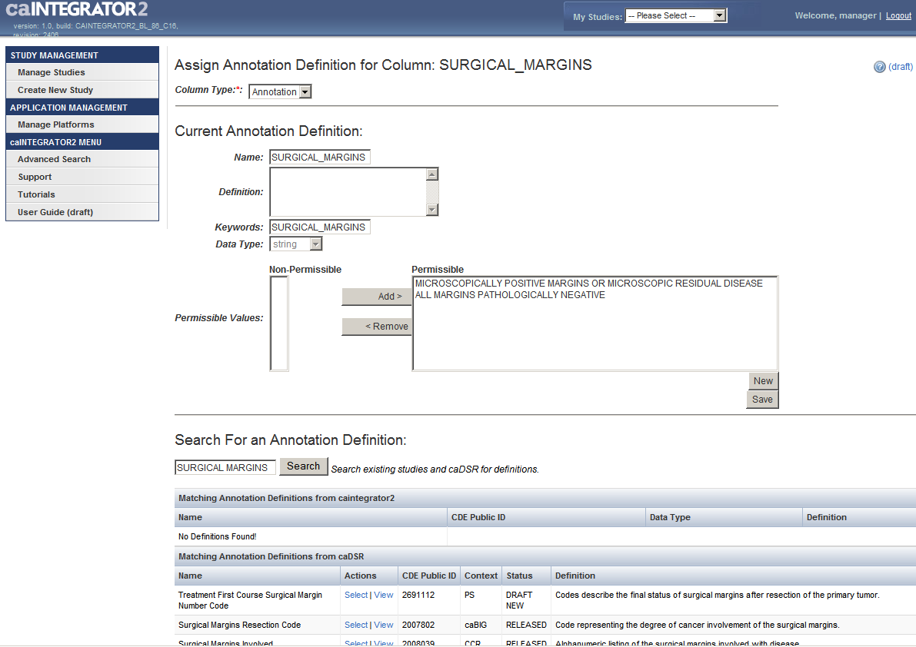
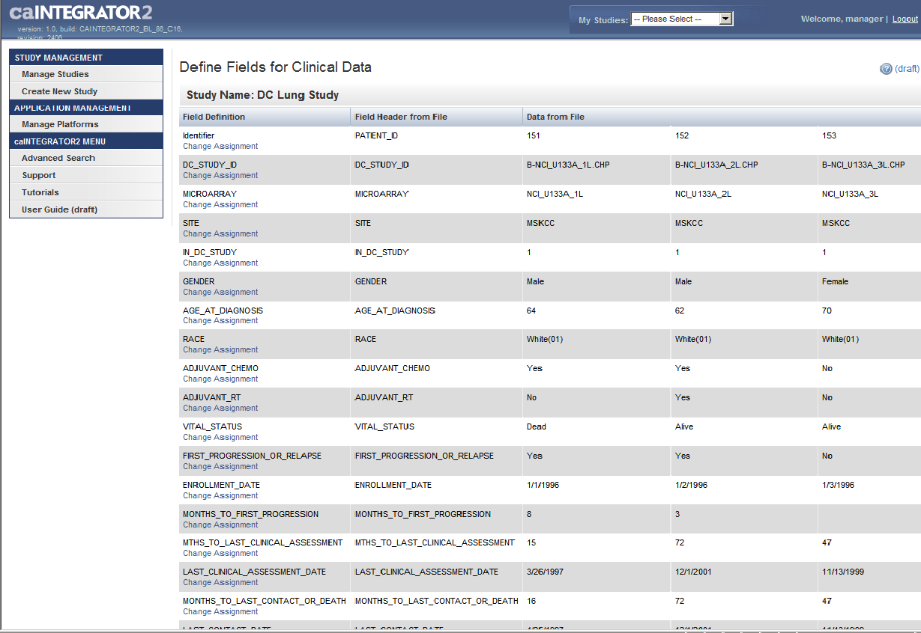
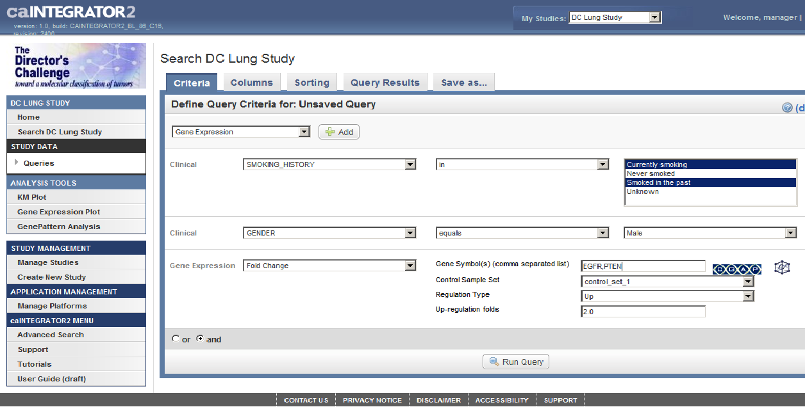
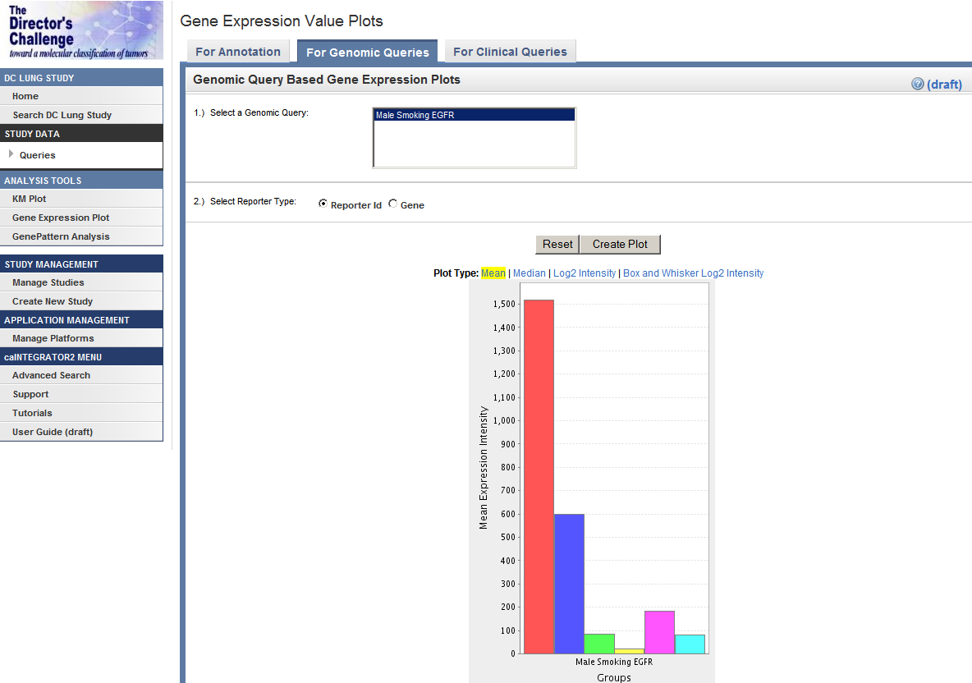
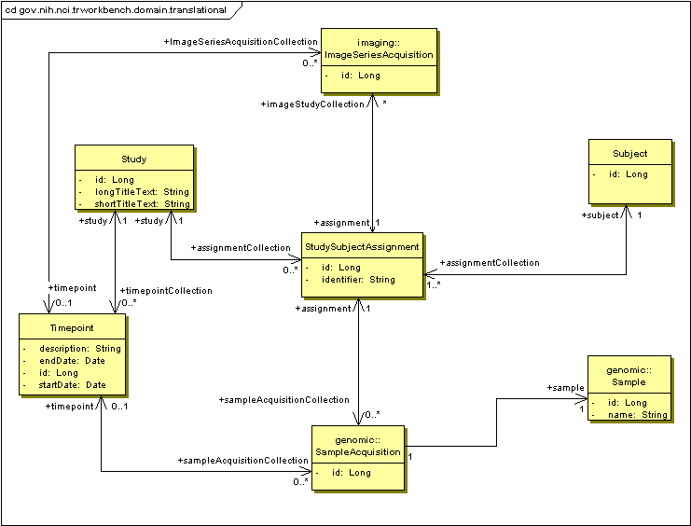
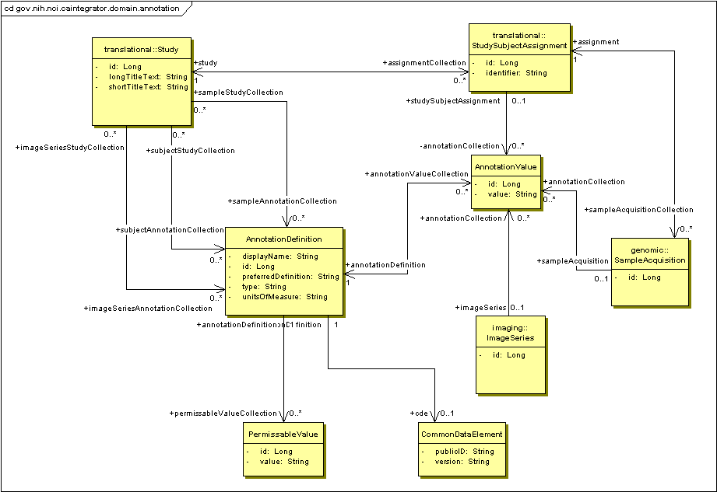

caIntegrator2: Translational Research Tool for the 21st Century
FitzHugh, W.³, Jacobs, S.³, Tavela, E.³, Marple, J.³, Andrews, T. ⁵, Nguyen, N.⁴, Liu, H.² , Hadfield,J.¹,Wong, C.¹, Basu, A.¹
NCI¹, SAIC², 5AM Solutions³, NTVI⁴, ScenPro⁵
Abstract
Use Cases
caIntegrator2 is a software package that allows users to set up their own custom caBIG®-compatible translational research web portals that bring together heterogeneous clinical, microarray, and medical imaging data. Deploying these custom portals does not require any custom software development and is accomplished through a web interface. The resulting portals allow querying, browsing, exporting and analyzing the study data in an integrated manner.
C3D
(Cancer Center Clinical Database)
Clinical Data
OR
caIntegrator2
Query and Browse Study Data: Research Investigators can browse and filter lists of study objects, such as patients, image series and genes. caIntegrator2 integration with caBIO enhances the gene query functions. They can also run and create queries that can produce lists of any objects and their associated annotations, in a specified order. The query results can be saved or exported to spreadsheets.
Clinical Annotation Spreadsheet
caArray
Description
Genomic Data
(mRNA expression, array CGH)
NCIA
(National Cancer Imaging Archive)
Image Annotation Spreadsheet
The resulting caIntegrator2 portals enable researchers to execute, save and share queries across the multiple data domains. caintegrator2 uses existing analytical services available on caGrid such as GenePattern and BioConductor to perform data analysis on the integrated study data. It also has built-in facilities for analyzing clinical survival data (KM plots) as well as gene expression plots and fold change queries. It takes advantage of caDSR to map study data to well-defined data types. It uses caGrid API’s to pull data from caBIG applications such as caArray, NBIA and caTissue. caIntegrator2 is well-suited for analysis and dissemination of data from integrative translational research studies.
Patients in Study
Imaging Data
GeWorkbench
GenePattern
Kaplan-Meier Plots
Deploy Study: The Study Manager defines the sources of data for a new study. The data is then accessed over the Grid or uploaded from files. The Study Manager defines relationships between patients and samples so that data can be compared reliably across the data sources. The Study Manager also defines the mapping of uploaded annotation fields to caDSR datatypes.
Perform Analysis: Data from caIntegrator2 can be sent to other software packages for more sophisticated analysis. GenePattern and GeWorkbench are available for clustering and classification analysis and several other analysis tools are built in, including gene Expression plots and Kaplan-Meier survival plots.
Web Interface
Object Model
Deploy Study: These page shows how the Study Manager can search and map each uploaded clinical data field to a caDSR datatype. The detailed datatype description, field type (number, date, yes/no, etc.) and allowable values can then be read from caDSR and used to validate the data. Study Manager will have the option to reuse the annotation on future studies.
Manage Queries: These page allows the Study Manager to create and manage queries that can be shared with all researchers who have access to the study. These queries can access all fields from all data sources and complex queries can be built up from logical combinations of simpler queries. The queries can also look for correlation relationships such as genes that are up-regulated in a certain tumor type determined by imaging. The queries can be used for perform analysis like gene expression and Kaplan-Meier plots.
Translation Data Model: This object model shows the relationship between study subjects (patients) and the genomic and imaging data that is acquired from them. In addition, multiple timepoints can be defined for a study so that imaging and genomic data can be gathered multiple times. An example of timepoints would be ‘At Diagnosis’ and ‘After Treatment’.
Annotation Data Model: This object model shows how annotations are stored. Annotations can be associated with patients, genomic samples and image series. The Common Data Element object defines a relationship with a caDSR datatype if an appropriate one can be found.
Future Directions
Support for new data types like methylation and new platforms like next-gen sequencing.
Correlation of prospective and retrospective clinical data with image data for using images as surrogate markers to predict treatment responses.
Integration with visualization tools like PCA viewers, heat maps, and genome browsers.
Coordinate with imaging communities to improve image analysis and feature prediction outcomes.
caBIG™ Annual Meeting July 20-22, 2009 - Washington, DC

